Slide 1


Enron North America
Power/Gas Origination
Report Date- August 23, 2000
Confidential

Slide 2
Power/Gas Origination
Project Objective:
Our review was designed to identify and test key policies, procedures, and controls to determine timely and effective review and approval of originated transactions.
AA Team Members: Enron Team Members:
Tom Bauer Brian Redmond
Patty Grutzmacher Janet Dietrich
Jennifer Stevenson Billy Lemmons
Sean Kiehne Ed McMichael
Dana Carr Berney Aucoin
Sharon Smith

Slide 3
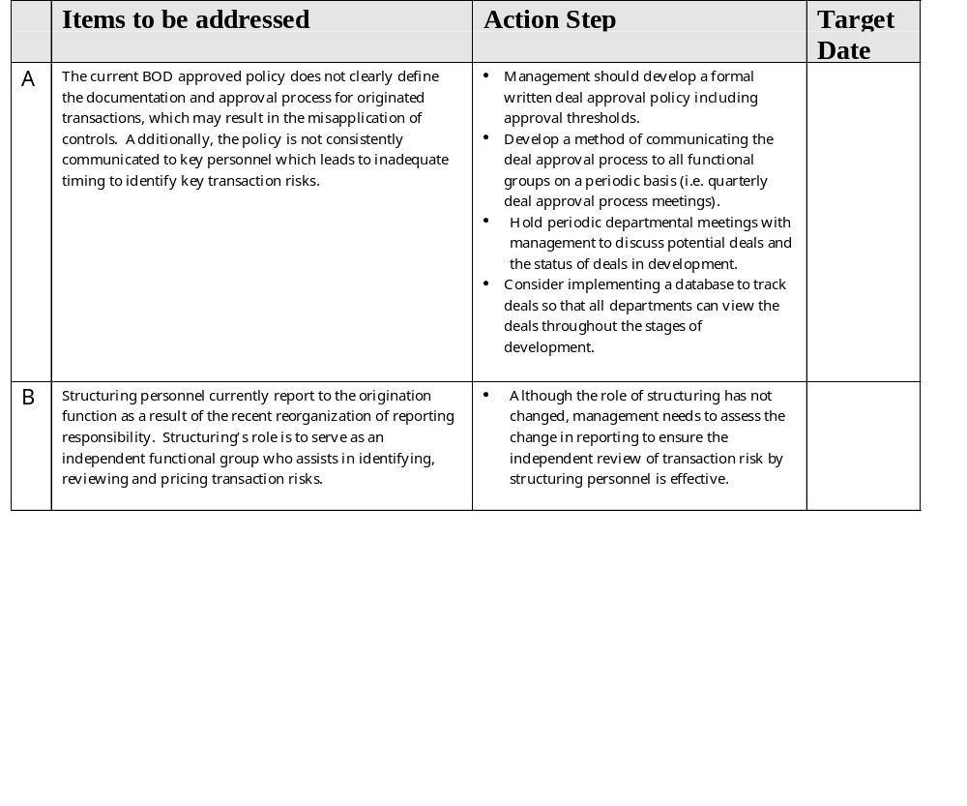
Power/Gas Origination

Slide 4
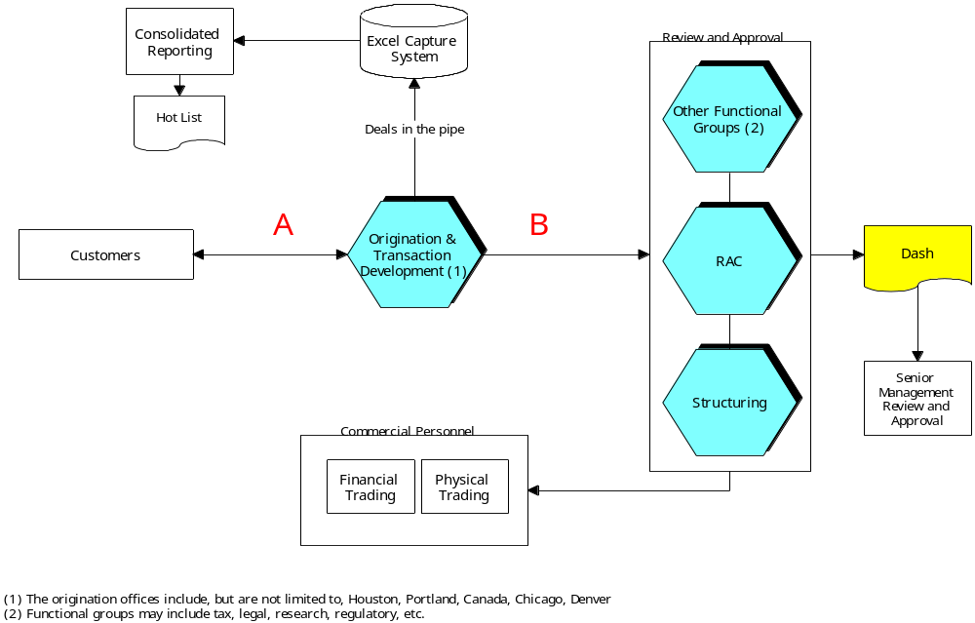
Power/Gas Origination

